Slide 1
CHAPTER 4 Optimal Predictive Control 2 Prediction structures and degrees of freedom
Anthony Rossiter

Slide 2
Background
The key weakness of GPC is the use of finite horizons.
In order to ensure a well-posed optimisation, one must include in the class of predictions, those which converge asymptotically.
This class must also include the global optimum.
One could consider the global optimum is to some extent arbitrary, but one needs to determine what definition will be used for this.
Typically the community uses a 2-norm measure over infinite horizons.

Slide 3
Definition of global optimum
Optimum is defined as the control trajectory which minimises the following performance index.
For a linear system, the corresponding control trajectory, and indeed control law, is well defined in the literature.
FOR CONVENIENCE, THIS CHAPTER USES STATE SPACE MODELS AS THE ALGEBRA WITH CARIMA MODELS IS SOMEWHAT CUMBERSOME WITHOUT ADDING USEFUL INSIGHT.

Slide 4
Linear quadratic regulators
Optimal control is a standard topic in most control curricula.
For a simple state space model:
And an infinite horizon performance index (assumes the target is zero for now).
The optimal control law is given from:

Slide 5
Asides
MATLAB includes built-in m-files for computing the matrices S and K.
[K,S] = dlqr(A,B,Q,R)
What is the point of MPC?
If the optimal control law can be solved so simply, what is the purpose of predictive control which is a suboptimal alternative?
Constraint handling is the answer! [Put to one side for now]

Slide 6
Predictive control with a class of optimal predictions
The LQR optimal predictions can be determined using a combination of:
These imply that:
Predictions follow directly from chapter 2 (see next page).

Slide 7
Optimal predictions
Using the model and compensator equations recursively, one can easily determine the following:
There is no flexibility in these predictions so how can MPC influence the choice of the current control move?

Slide 8
Adding d.o.f. to create a viable class of predictions
MPC needs some d.o.f. within the predictions which can be deployed to improve behaviour.
So far we have defined only the optimal LQR predictions (for zero set point etc.).
The easiest d.o.f. to add is some flexibility in the choices of input over the immediate transients, as it is usually the immediate transients where decision making focuses most attention (as long as the long term is known to be safe and sensible).

Slide 9
Adding d.o.f. to LQR predictions
Add some flexibility to the first few control moves within the predictions that would arise using the LQR feedback:
Combine this feedback law with the model equation?

Slide 10
Perturbed predictions
Using the model and compensator equations recursively, one can easily determine the following:
Similarly

Slide 11
Optimal MPC (OMPC)
Take the predictions based around the implementation of an LQR regulator and some perturbations.
Optimise predicted performance w.r.t. to the perturbations and implement the first value.

Slide 12
Aside: Dual-mode predictions
These predictions are commonly called dual-mode because there are two clearly distinct dynamics for transients and asymptotic behaviour:
Transient mode for 1st n_{c} steps
Terminal mode for asymptotic behaviour beyond 1st n_{c} steps

Slide 13
Observations of OMPC
By definition, for the unconstrained case, the optimal value of the future inputs minimising J is given by:
This means that, in the unconstrained case, the optimum value for the future input perturbations c_{k} should be zero. Consequently, it is easy to show that:
Simple and well conditioned.

Slide 14
Summary
In order to produce the ‘desired’ closed-loop behaviour, the class of predictions should include the desired closed-loop behaviour.
If predictions are based on perturbations around an LQR regulator, this can be achieved.
The dual-mode predictions implicitly evolve over an infinite horizon, as expected/desired.
The optimisation is well-conditioned – in fact the optimum for the unconstrained case will always be c_{k}=0.
The optimisation at each sample will give the same results as the previous sample (nominal case) which emphasises that the optimisation is well-posed.

Slide 15



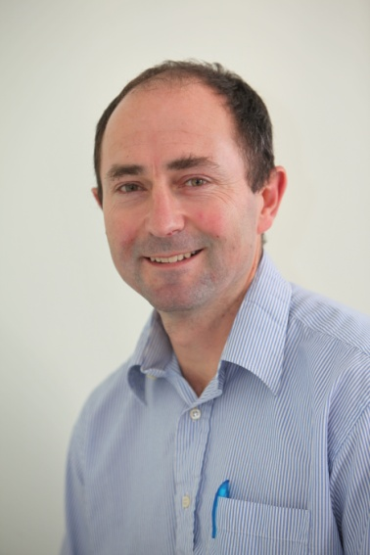
Anthony Rossiter
Department of Automatic Control and Systems Engineering
University of Sheffield
www.shef.ac.uk/acse
© 2014 University of Sheffield
This work is licensed under the Creative Commons Attribution 2.0 UK: England & Wales Licence. To view a copy of this licence, visit http://creativecommons.org/licenses/by/2.0/uk/ or send a letter to: Creative Commons, 171 Second Street, Suite 300, San Francisco, California 94105, USA.
It should be noted that some of the materials contained within this resource are subject to third party rights and any copyright notices must remain with these materials in the event of reuse or repurposing.
If there are third party images within the resource please do not remove or alter any of the copyright notices or website details shown below the image.
(Please list details of the third party rights contained within this work.
If you include your institutions logo on the cover please include reference to the fact that it is a trade mark and all copyright in that image is reserved.)

